Slide 1

Building a game with logic

Slide 2
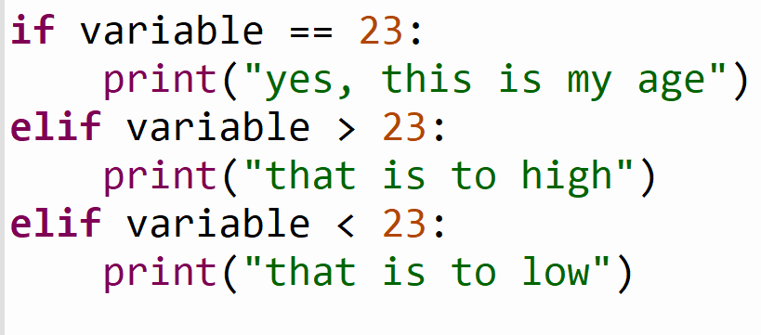
Example

Slide 3
X = 600
Y = 800
We have a grid of 800x600

Slide 4
X = 600
50
50
Y = 800
We have a player of 50x50

Slide 5
X = 600
Y = 800
We want to place the player in the middle of the screen

Slide 6
X = 600
Y = 800
If we place the player on (0,0) it will be in the bottom left corner

Slide 7
X = 600
Y = 800
What vector is needed to get it in the middle?
Player = (a,b)

Slide 8
X = 600
Y = 800
A = (x / 2) – 25 || A = (600 / 2) – 25
B = (y / 2) – 25 || B = (800 / 2) – 25
(275,375)

Slide 9
Player = (275,375)
X = 600
Y = 800
No we want to move. If we press ‘D’ or ‘right arrow’,
what should happen with Player?

Slide 10
Player = (275,375)
X = 600
Y = 800
No we want to move. If we press ‘D’ or ‘right arrow’,
what should happen with Player?
Player.y = Player.y + 1 || Player.y = 375 + 1

Slide 11
Player = (275,375)
X = 600
Y = 800
If we press ‘A’ or ‘left arrow’,
what should happen with Player?

Slide 12
Player = (275,375)
X = 600
Y = 800
If we press ‘A’ or ‘left arrow’,
what should happen with Player?
Player.y = Player.y - 1 || Player.y = 375 - 1

Slide 13
Player = (275,375)
X = 600
Y = 800
If we press ‘W’ or ‘up arrow’,
what should happen with Player?

Slide 14
Player = (275,375)
X = 600
Y = 800
If we press ‘W’ or ‘up arrow’,
what should happen with Player?
Player.x = Player.x + 1 || Player.x = 275 + 1

Slide 15
Player = (275,375)
X = 600
Y = 800
If we press ‘S’ or ‘down arrow’,
what should happen with Player?

Slide 16
Player = (275,375)
X = 600
Y = 800
If we press ‘S’ or ‘down arrow’,
what should happen with Player?
Player.x = Player.x - 1 || Player.x = 275 - 1

Slide 17
Player = (275,375)
X = 600
Y = 800
If we hold ‘S’ the block will keep moving down
Also out of the screen

Slide 18
Player = (275,375)
X = 600
Y = 800
If we hold ‘S’ the block will keep moving down
So how do we make it stop at the edge?

Slide 19
Player = (275,375)
X = 600
Y = 800
No do the same for top, left and right border
So how do we make it stop at the edge?

Slide 20
Summary

